Slide 2
AGENDA
February 28, 2024
President: Rose Feeney
🍷 Welcome
🍷 Words of Wisdom
🍷 New Members & Guests
🍷 Dues are being collected by Sheila tonight for Cathleen, $50 for 2024
Kevin Holloway: Cork Purchase Update

Slide 3
Gary Alvey:
🍷 Website
🍷 Member Area
🍷 Bob Bennett’s (GENCO’s Founder) Celebration of Life
Mary Lou Marek:
🍷 Update on GENCO Wine Competition - May 2nd
🍷 “Save the Date” for Awards Dinner - May 18th
~ Social Afterward Tonight ~
🍷

Slide 5
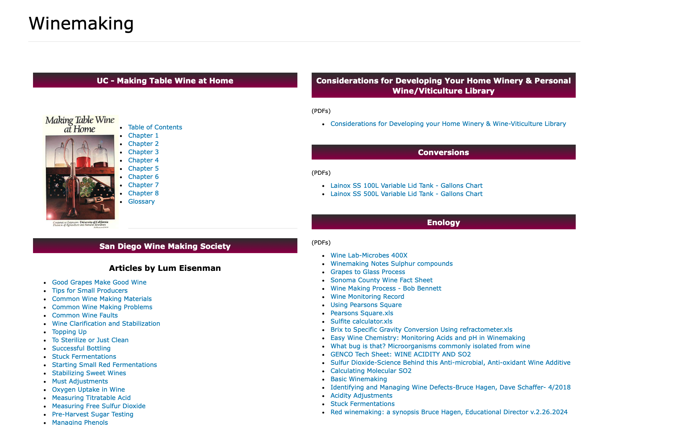
Bruce Hagen:
🍷 Tonight’s Program: Introduction to RED WINE Making

Slide 6
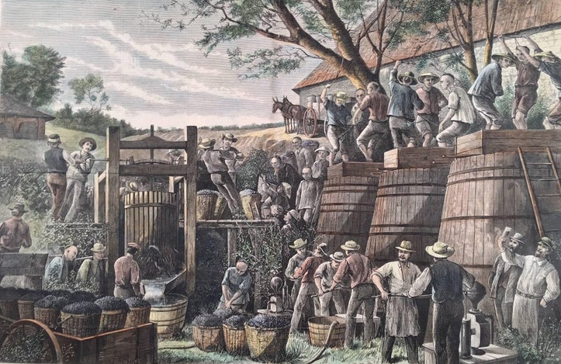
An introduction to red winemaking:
The vintage in California, Harper’s Weekly, 1859
People have long enjoyed red wines for their intense colors, complex aromas and flavors, and rich mouth-feel …

Slide 7
History of winemaking:
evolution of ideas, scientific knowledge, technology, and cultural practices
Romans introduced: pruning vines, cultivating specific varieties, more efficient pressing, use of barrels, and SO₂.
They recognized: influence of vineyard location, climate, and laid groundwork for modern winemaking
The focus on traditional methods shifted during the Age of Enlightenment. Science, reason, and examination of traditional beliefs and practices, brought about many advancements.
Scientists and scholars began to study the chemical and biological processes behind fermentation, the role that yeast play, and factors influencing wine quality.
Ushered in an era of innovation: adoption of more controlled fermentation, temperature control, stainless-steel tanks, use of oak barrels, more precise control over wine production/quality.
We have an array of tools and techniques to produce wines: electricity, temperature control, hydraulic presses, pumps, filters etc.
We have a better understanding of vineyard management, grape genetics, and microbiology, yeast kinetics, etc. to make more informed decisions throughout the process.
We also have a variety of labor-saving and problem-solving products … We’ve come a long way since crushing grapes under foot and fermenting in earthenware tanks buried in the ground.

Slide 8
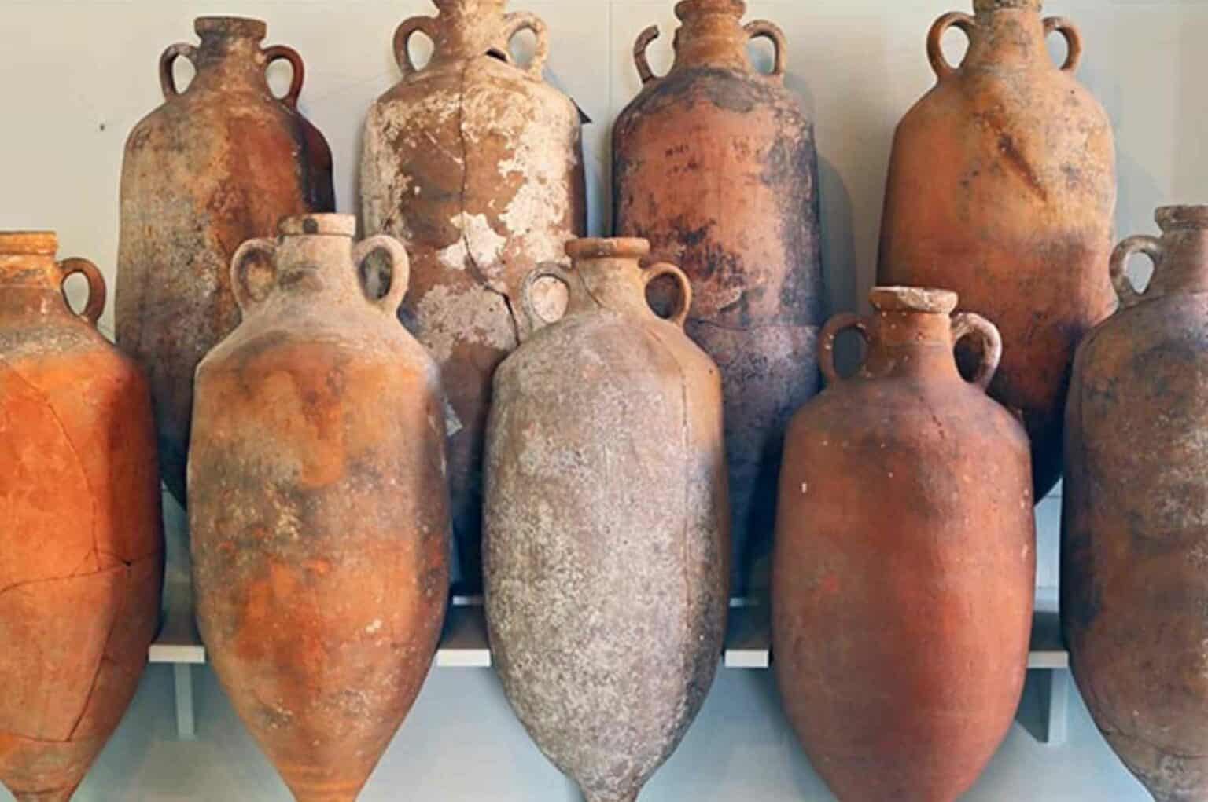
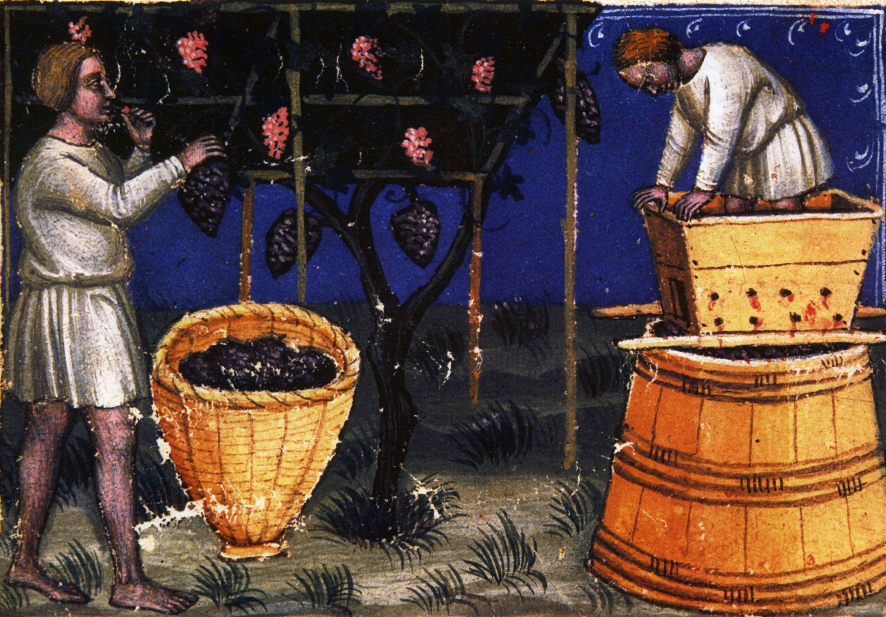
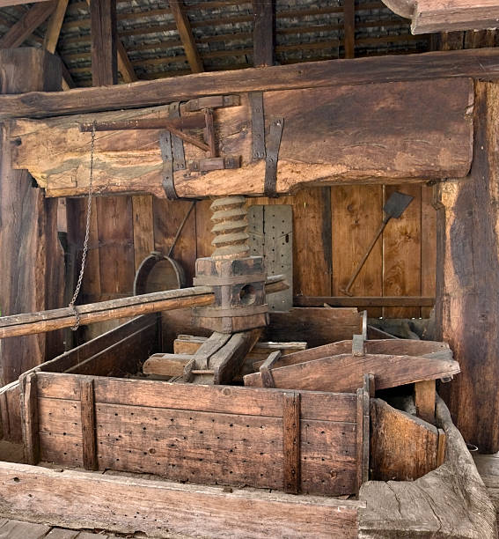
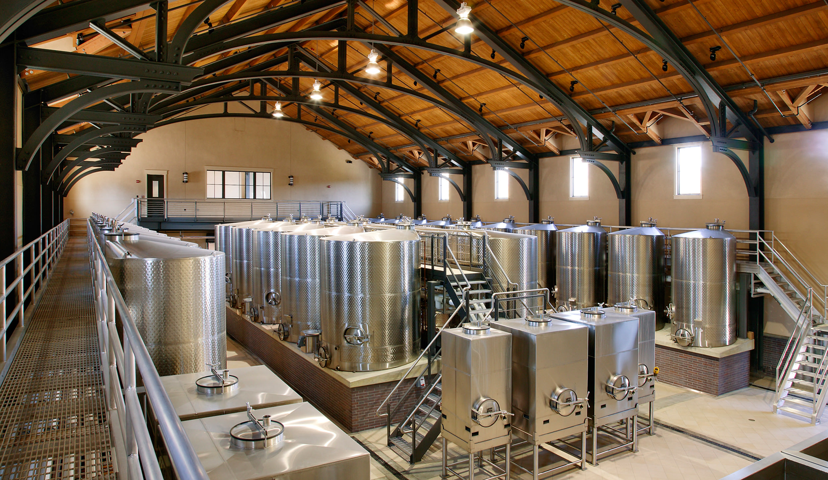
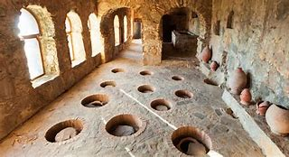
Qveveri in Georgia

Slide 9
Elements of red wines:
color, tannins, acidity, alcohol, sugar
fruit: (aromas and flavors), level of dryness, perception of sweetness
body: weightiness, volume, intensity, light vs. full, or lean vs. rich
balance: harmony of all elements
structure: interplay between balance, including aromas and flavors, and body

Slide 10
Tannins: (Polyphenolic cmpds.)
that dry, astringent, and sometimes bitter taste …
or that ripe, soft, supple, velvety richness … and depth of color
provide body, texture (mouthfeel)
from skins, seeds, stems, and oak
protect against oxidation, and allow reds to age gracefully
too much can be off-putting
the trick: knowing how to manage them
extraction promoted by: enzymes, warmer fermentations, higher alcohol, and more frequent punching
moderated by cooler fermentations, fewer punch-downs, more racking, fining

Slide 11
Process: From vine to bottle
harvest
keeping grapes cool
stemming/crushing/sorting
collecting grape ‘must’
chilling as needed
sulfiting
enzymes/tannins
skin-contact (maceration)
testing (before fermentation)
adjustments: acidity, °Brix
cold-soak
fermentation
tannins
nutrient management
punching-downs (maceration)
post-fermentation pressing/settling/racking
MLC
post-fermentation sulfiting
racking
maturation (bulk storage)/sulfiting
fining and clarification/racking/filtering
bottling/sulfiting

Slide 12
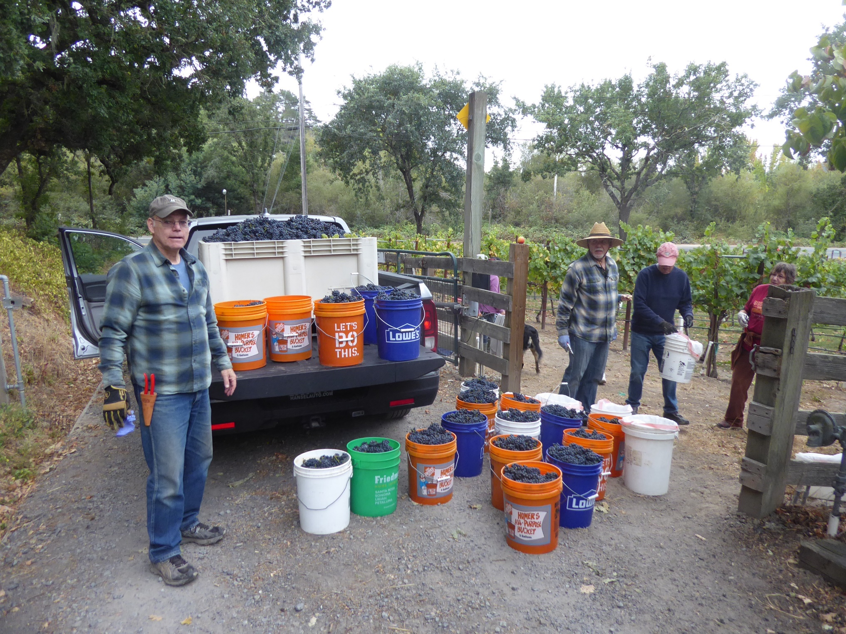

Slide 13
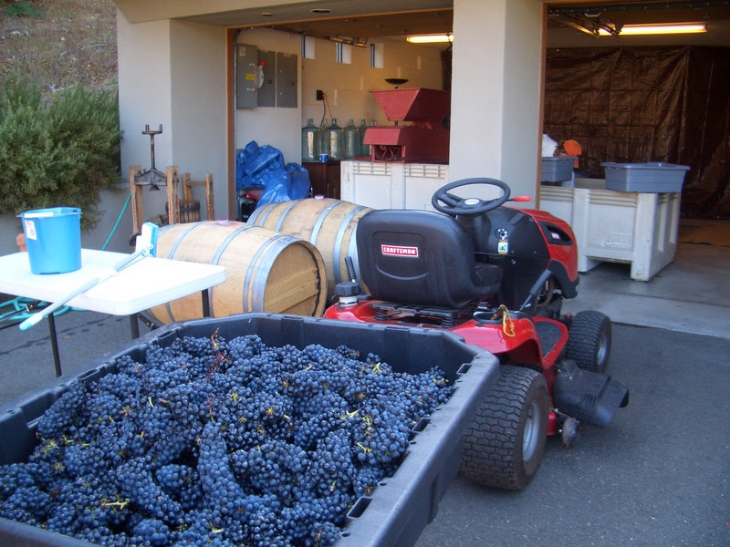

Slide 14
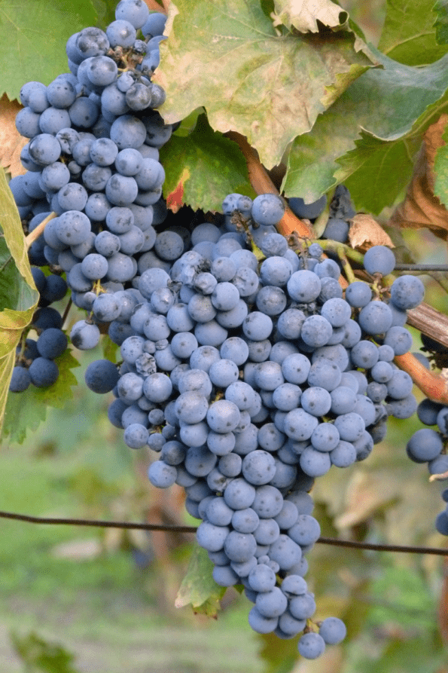
Harvest: knowing when to pick:
color and taste
ripe fruit flavors: sweet black berries, black cherries, black currants, rather than red cherry, cranberry, and pomegranate
when fully ripe, grapes should feel a little soft
stems and seeds mostly brown
Brix°

Slide 15
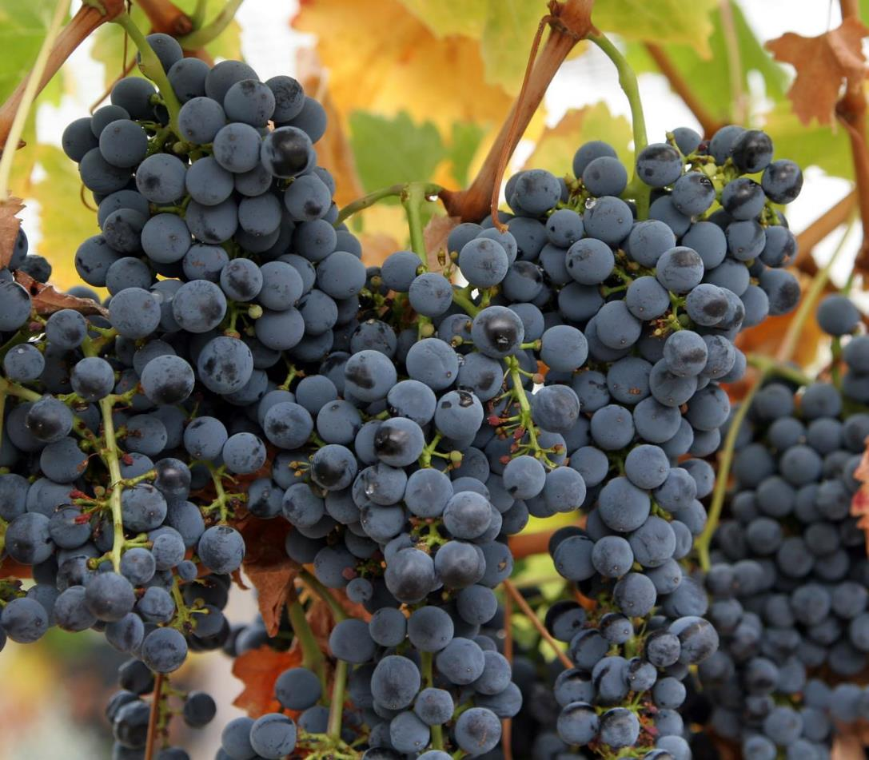
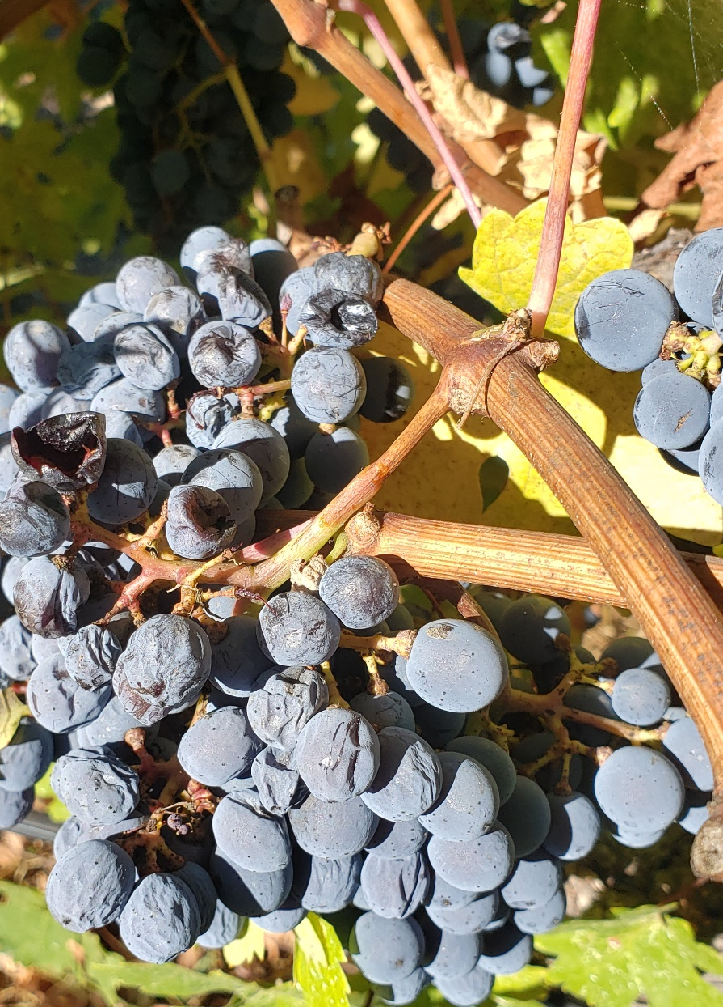
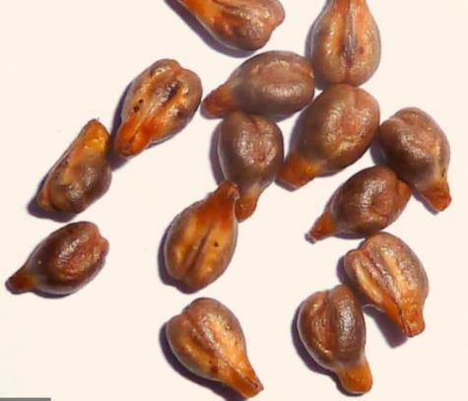

Slide 16
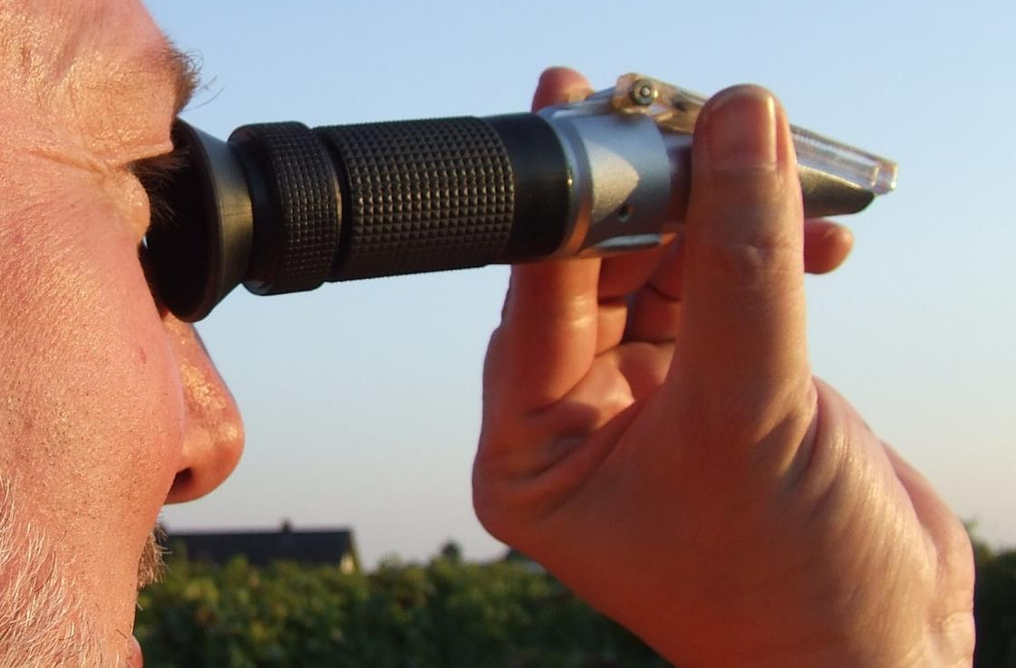
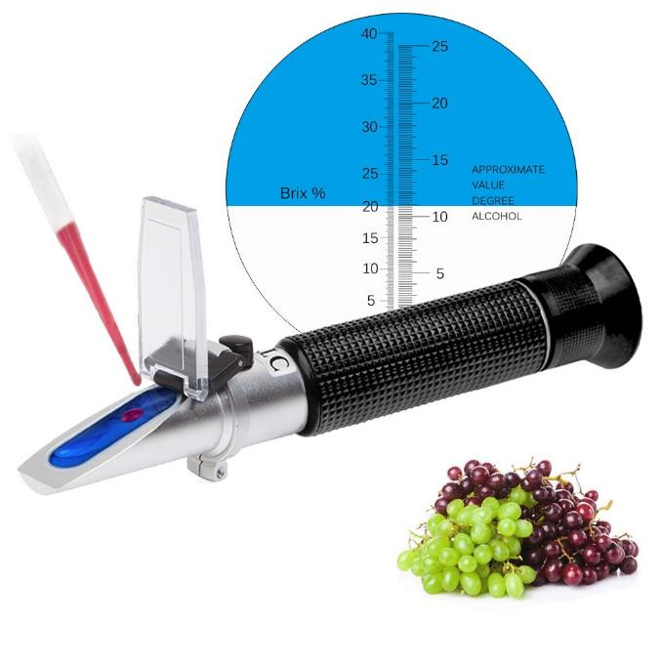
Refractometer

Slide 17
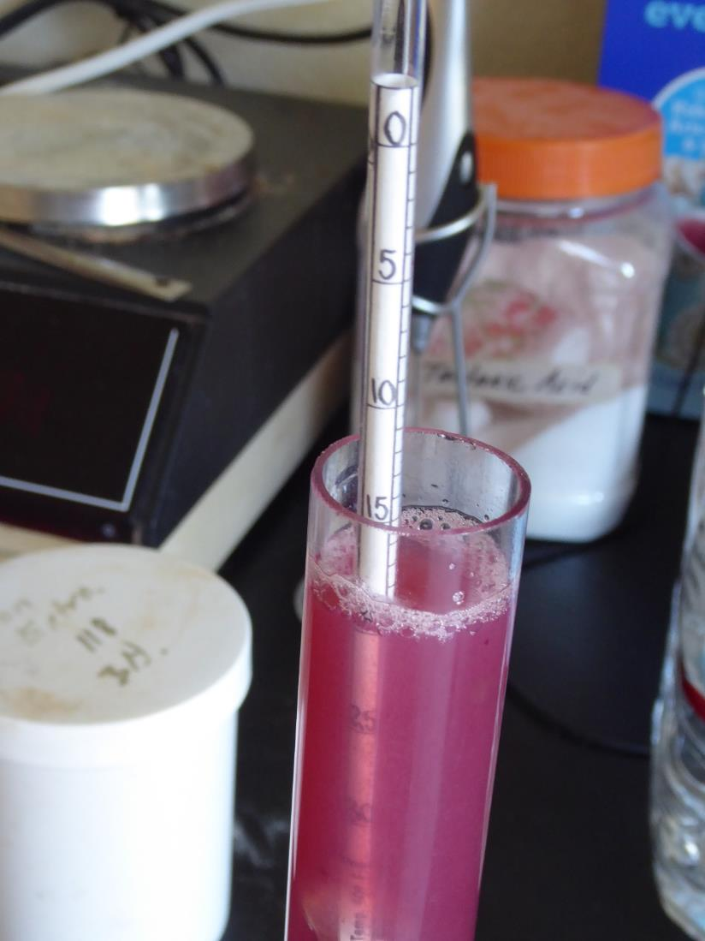
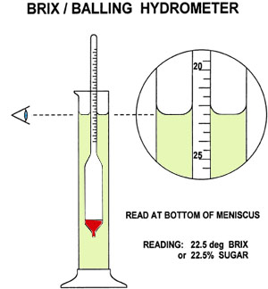
Specific Gravity or °Brix/Balling Hydrometer

Slide 18
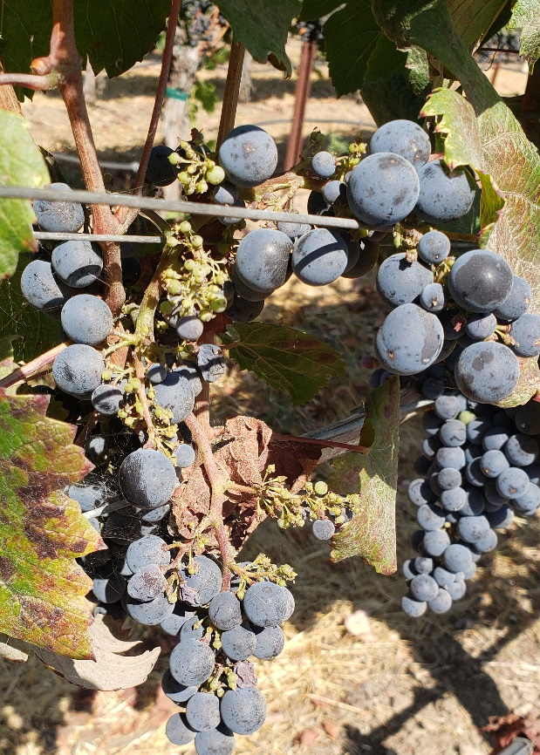
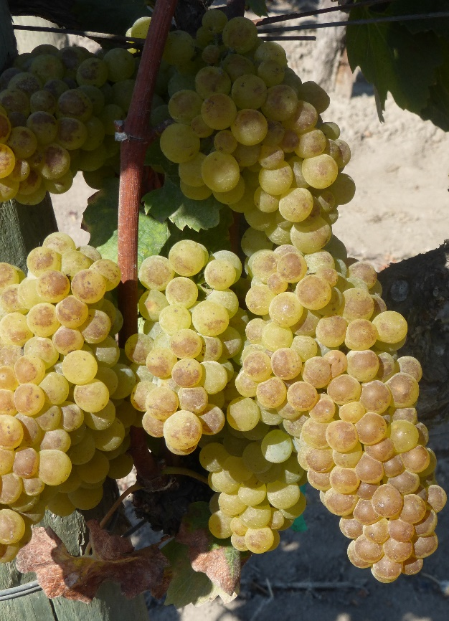
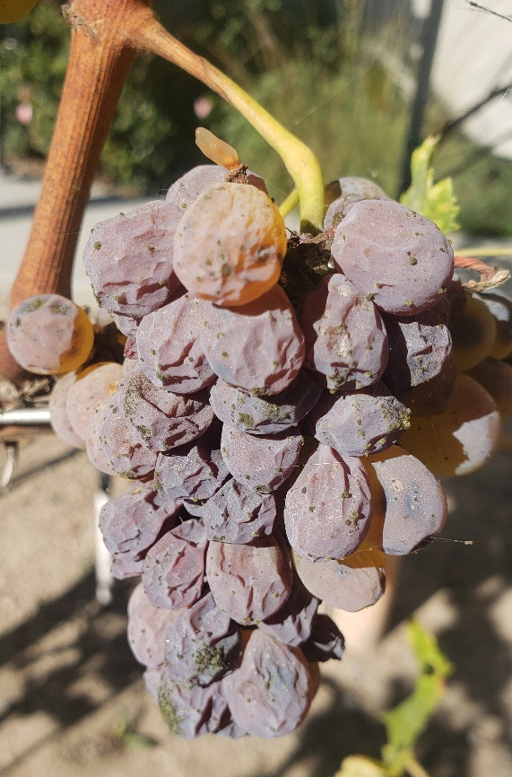
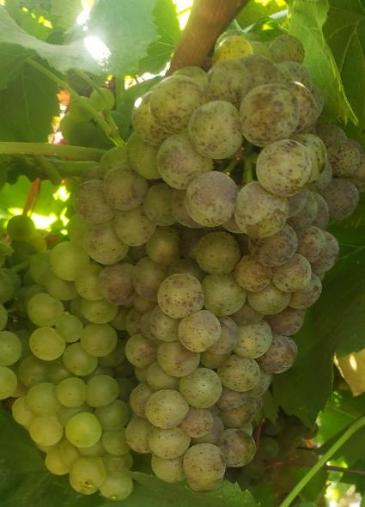
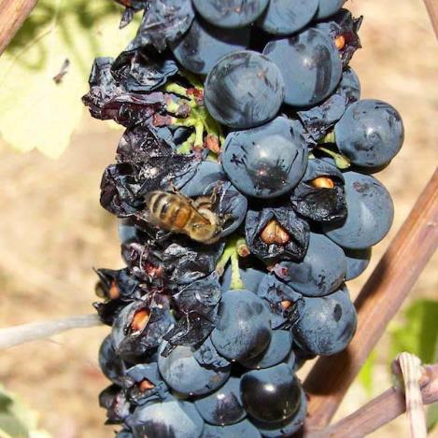
Avoid clusters with mold, mildew, rot, sunburn, shatter, physical damage, extensive raisining

Slide 19
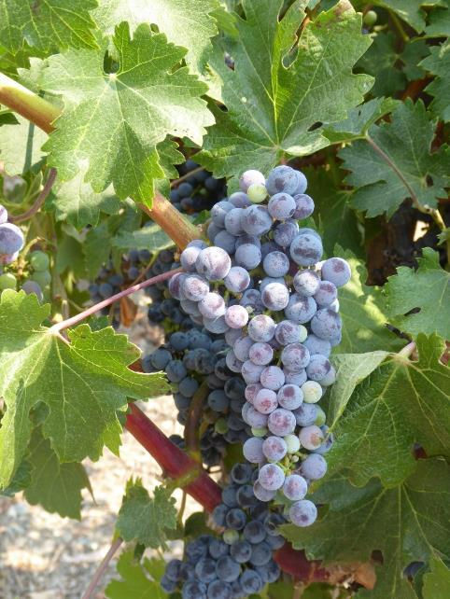
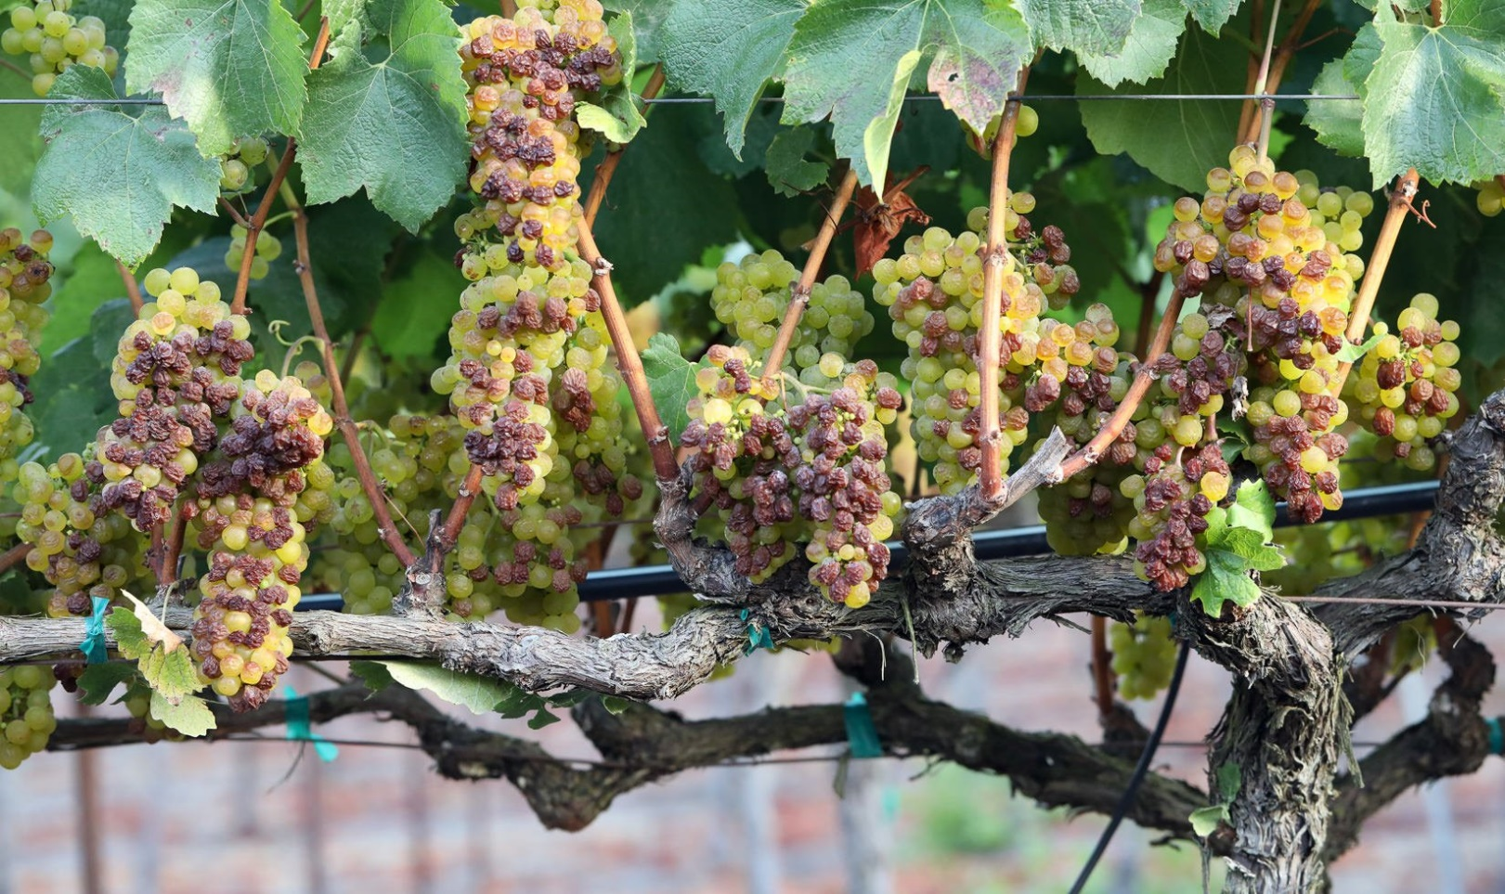
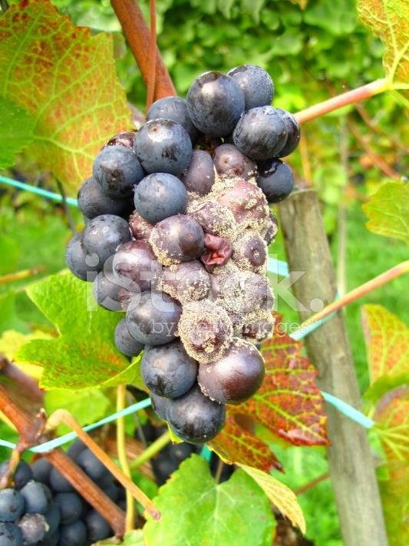
Avoid grapes with yellowish sulfur dust

Slide 20
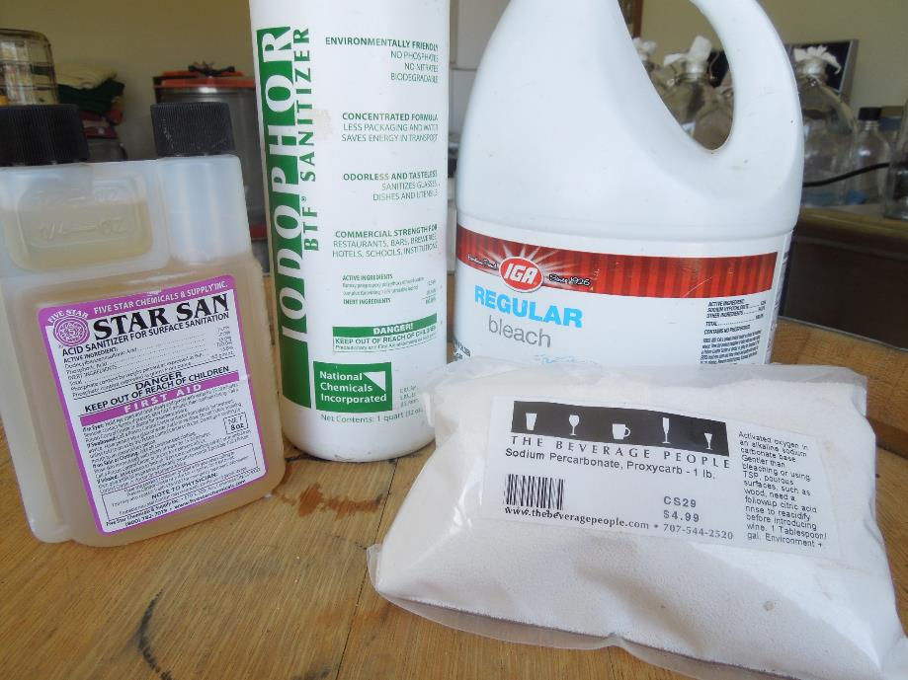
Sanitation: clean and sanitize everything that the grapes, juice, or wine will make contact with :
?

Slide 21
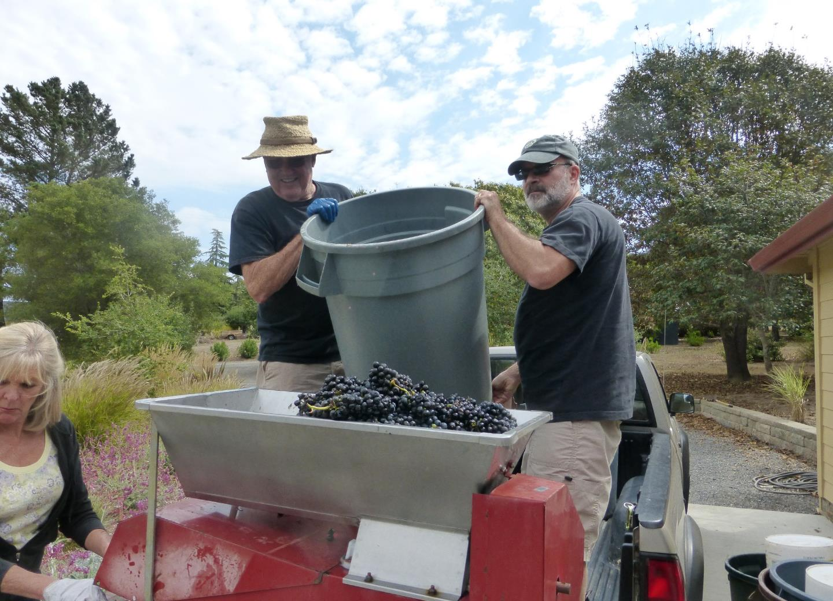

Slide 22
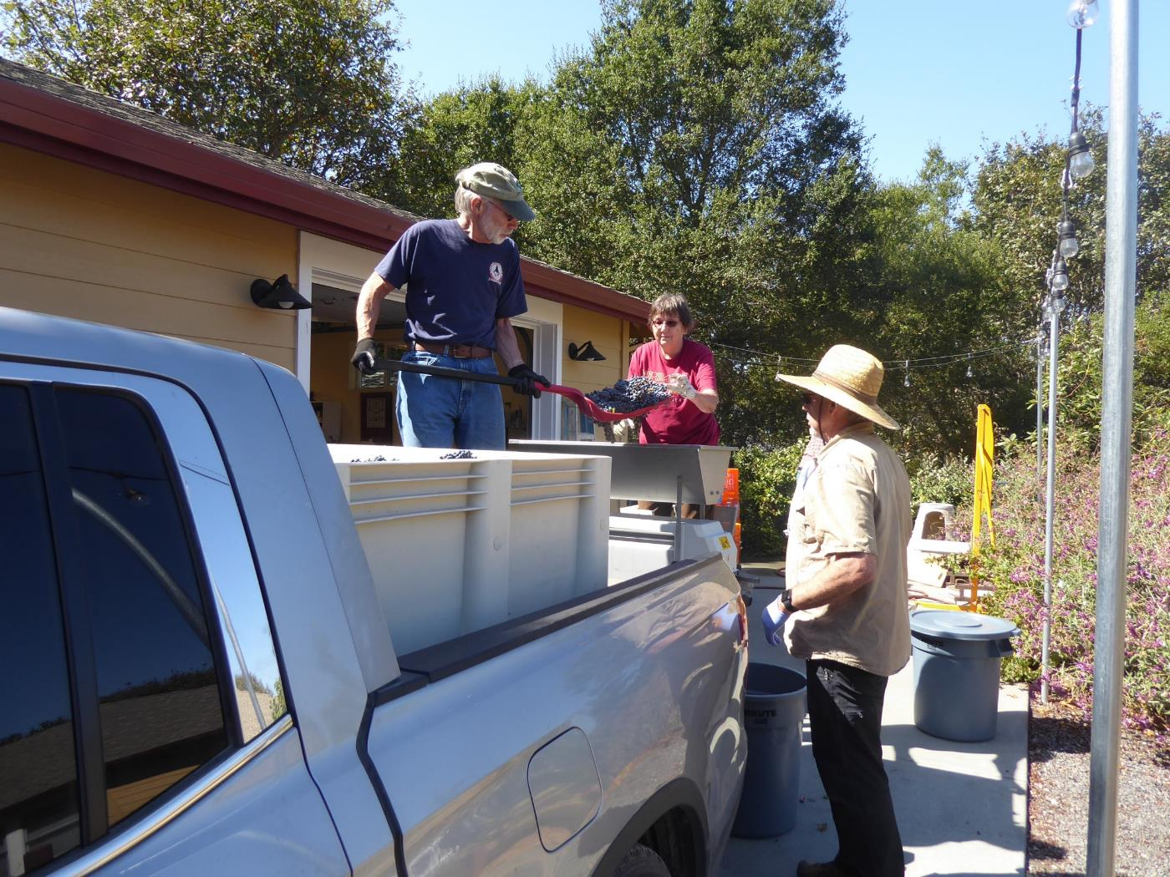

Slide 23
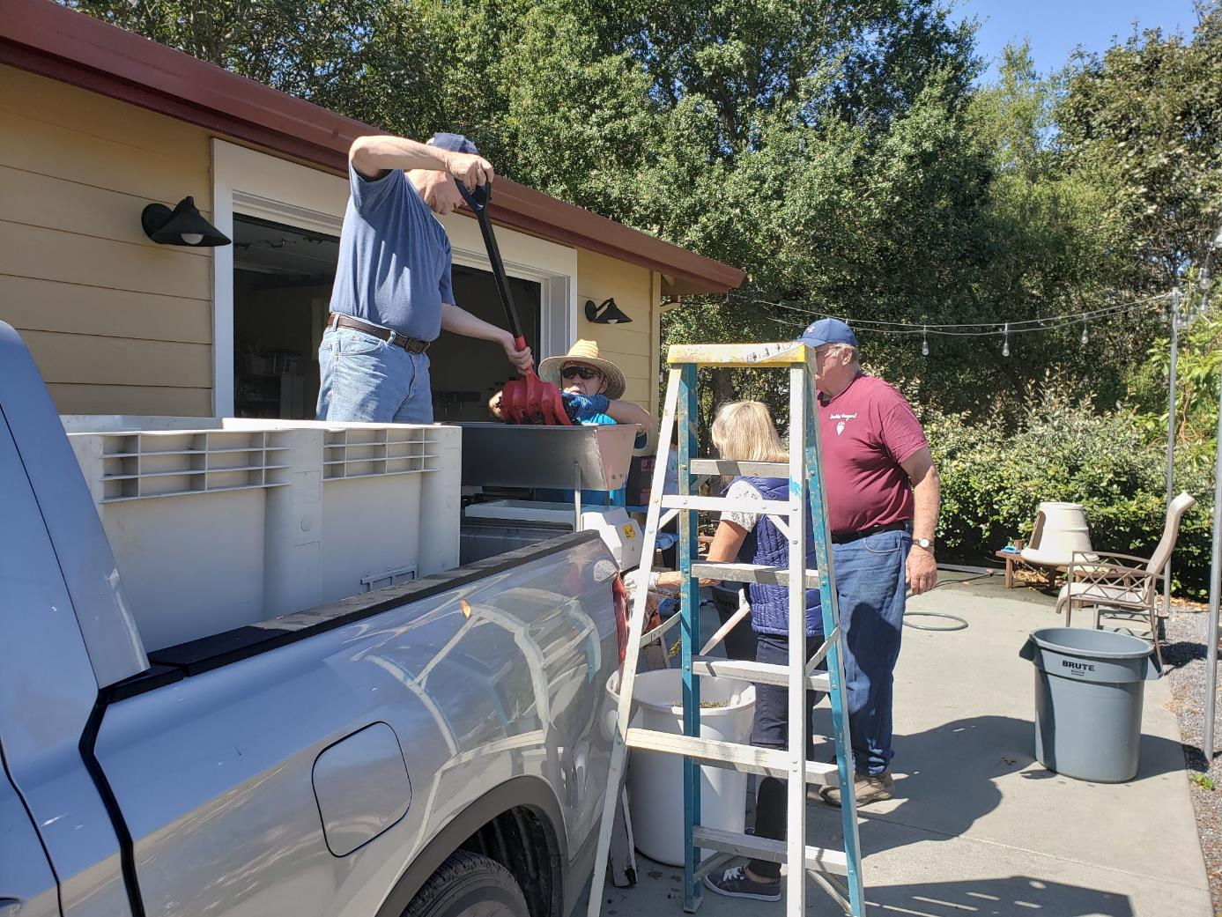

Slide 24
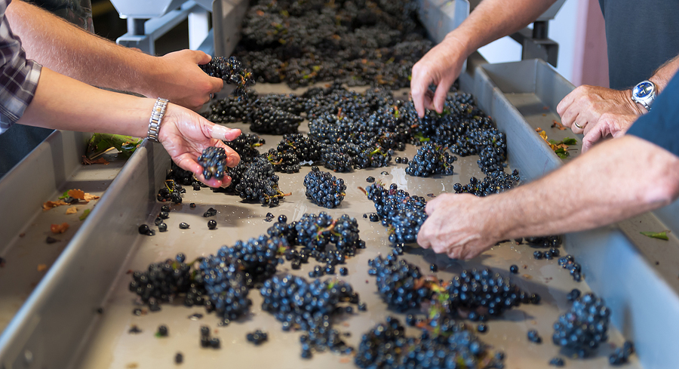

Slide 25
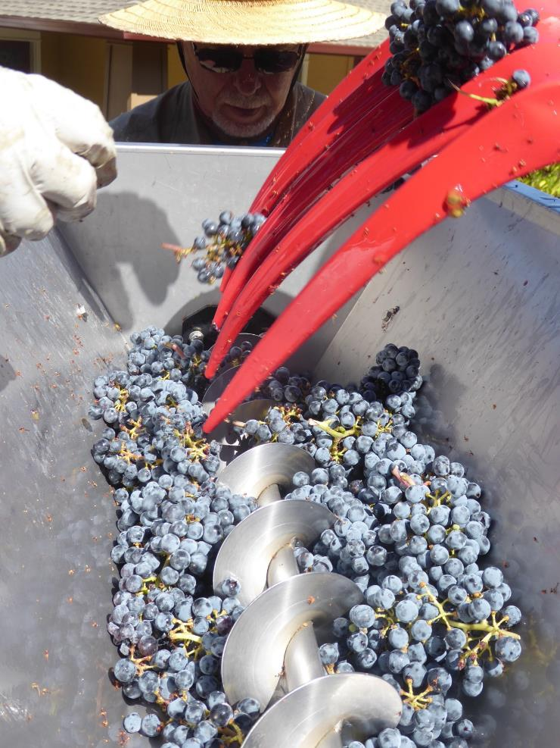
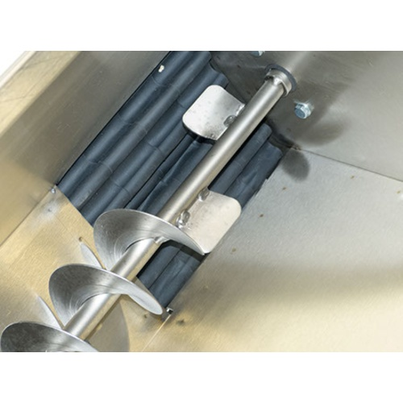

Slide 26
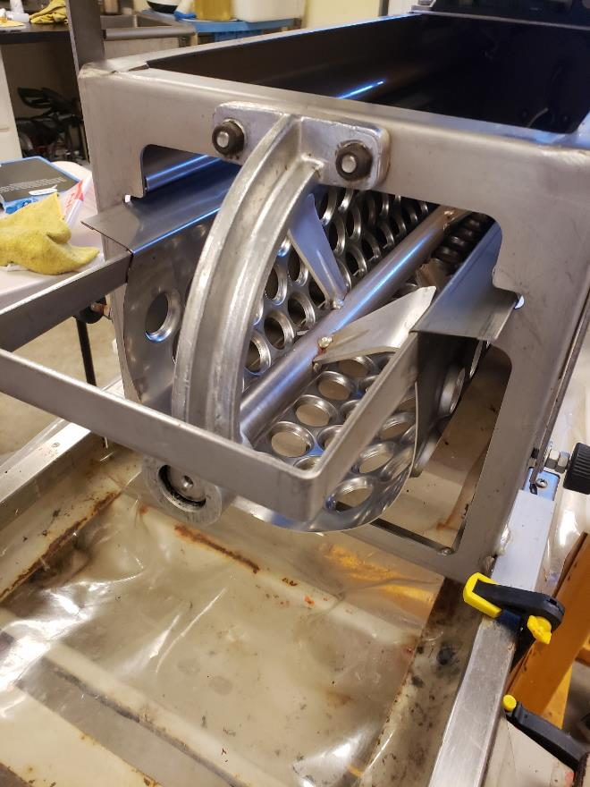
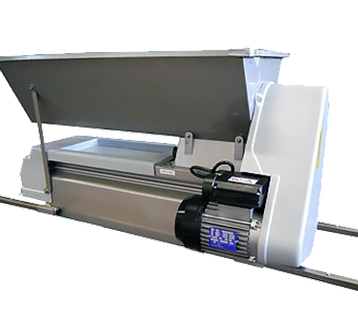

Slide 27
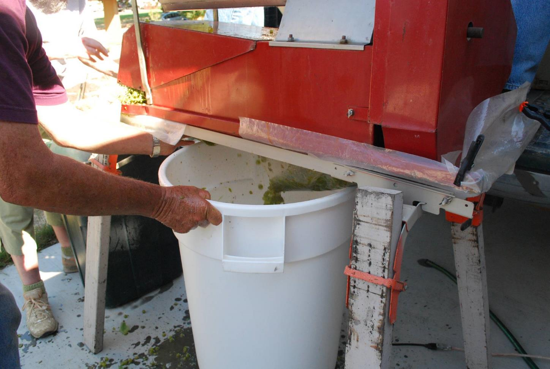

Slide 28
Pre-fermentation sulfite addition:
primarily to prevent microbial spoilage
also acts an antioxidant
based on volume of must
35 to 50 ppm (mg/L), more for warm, damaged grapes
chilling reduces amount of SO₂ needed
>50 ppm at fermentation may inhibit MLF
mix thoroughly before adding enzymes

Slide 29
Potassium Metabisulfite (Powder)
1000 lbs. of grapes produces about 90 gal. of must, after stemming and crushing, that’s ~3.5 hL (hL =26 gal)
actual volume depends on size of grapes
add 8.9 g/hL or 0.326 g/gal of must to add 50 ppm
a 32-gal food-grade fermenter holds about 1hL to the ring, so add ~9 g
in a macrobin, add 31.5 g (9 X 3.5 = 31.5 g)
least expensive

Slide 30
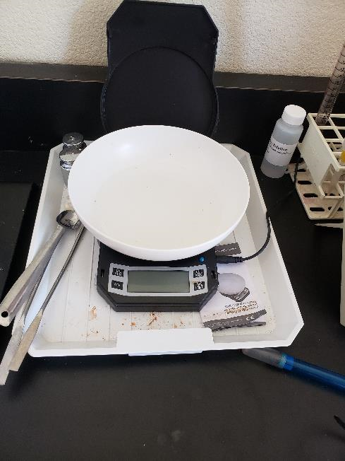
PMBS additions for must: based on a ton, 1/2-ton, or hLs of must :
Grams PMBS to add =
mg/L (ppm) desired SO₂ (total) x L (Liters) of must
0.56 X 1000
Potassium metabisulfite addition guidelines (winy: Enartis)
SO₂ (mg/L) g/hL (26gal.) g/barrel g/1,000 gal lbs./1,000 gal
5 0.9 2 33 0.07
10 1.8 4 65 0.14
30 5.4 12 196 0.43
50 8.9 20 326 0.72
60 10.7 23 392 0.86

Slide 31
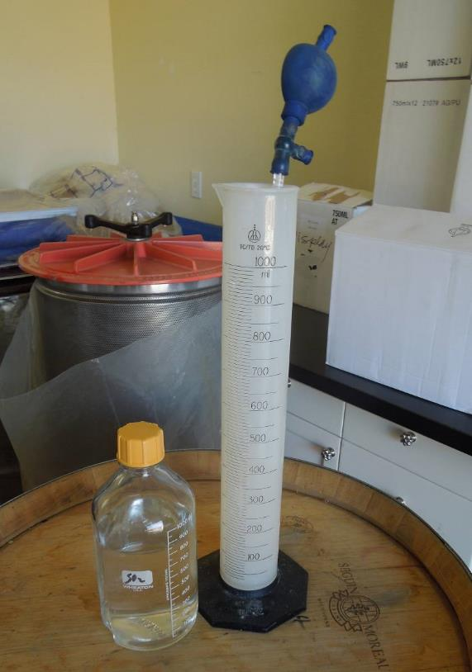
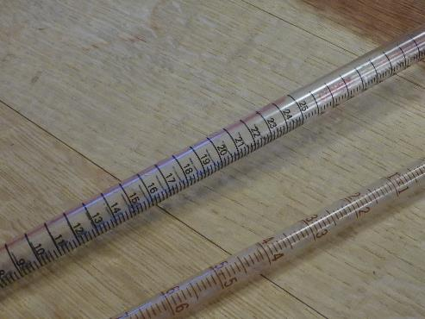
10% stock solution:
convenient, economic, needs stirring
75 g PMBS to a 750 ml bottle and fill ~25.4oz
100 g in a liter bottle and fill (~34oz)
1 ml per L of juice or wine is the same as 1 ppm: 1000 mg in a ml, and 1000 ml in a L

Slide 32
SO₂ addition: 10% (5.6%) solution (Winy: Enartis)
1 ppm = 1 mg/L
 | 5gal | 10 gal | 15 gal | 30 gal | 60 gal
10 ppm | 3.38 | 6.76 | 10.14 | 20.28 | 40.56
15ppm | 5.07 | 10.14 | 15.21 | 30.42 | 60.84
20 ppm | 6.76 | 13.52 | 20.58 | 40.56 | 81.12
25 ppm | 8.45 | 16.9 | 25.35 | 50.76 | 101.39
30 ppm | 10.41 | 20.28 | 30.42 | 60.84 | 121.67
35 ppm | 11.83 | 23.66 | 35.49 | 70.98 | 141.95
50 ppm | 16.9 | 33.8 | 50.7 | 104.39 | 202.79

Slide 33
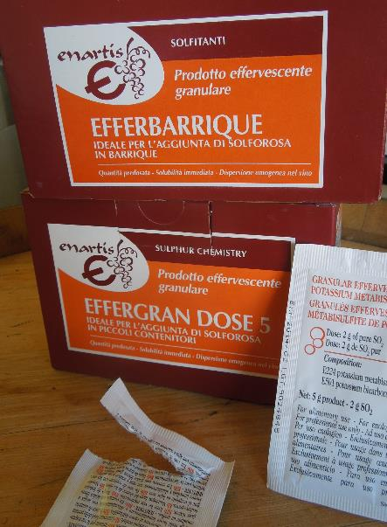
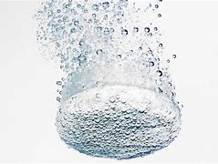
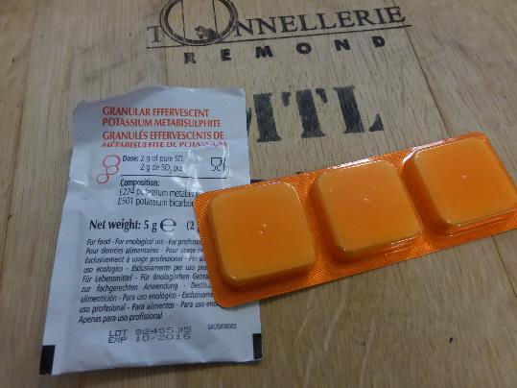
SO2 effervescent form:
More expensive, don’t need to measure and you don’t have to stir
Need 6 2-g packets/tabs to add 50 ppm to 25-gal of must in a 32-gallon fermenting bin
A 2-g packet will add 36 ppm to 15-gal of wine in a keg, and 9 ppm in a 59-gal barrel
A 5-g packet will add 23 ppm to 59-gal of wine
Best for dosing wine

Slide 34
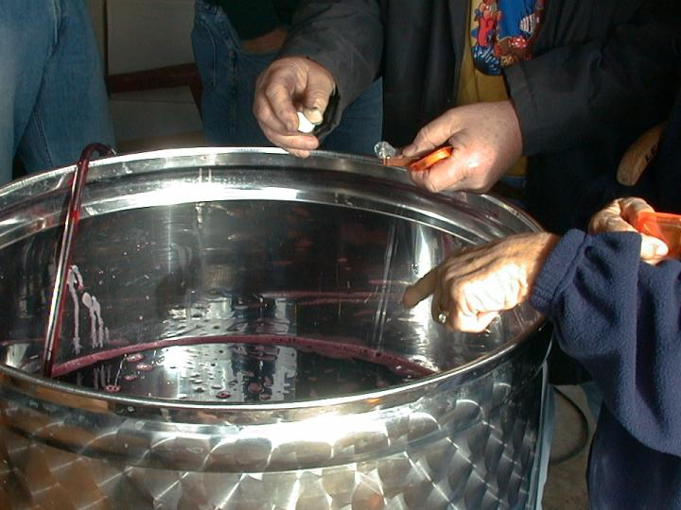

Slide 35
Maceration:
extraction of color, tannins, and flavor/aroma components from the skins as they soak and soften in the juice, ferment and later during MLC
adjust length and intensity of maceration – for desired style or variety

Slide 36
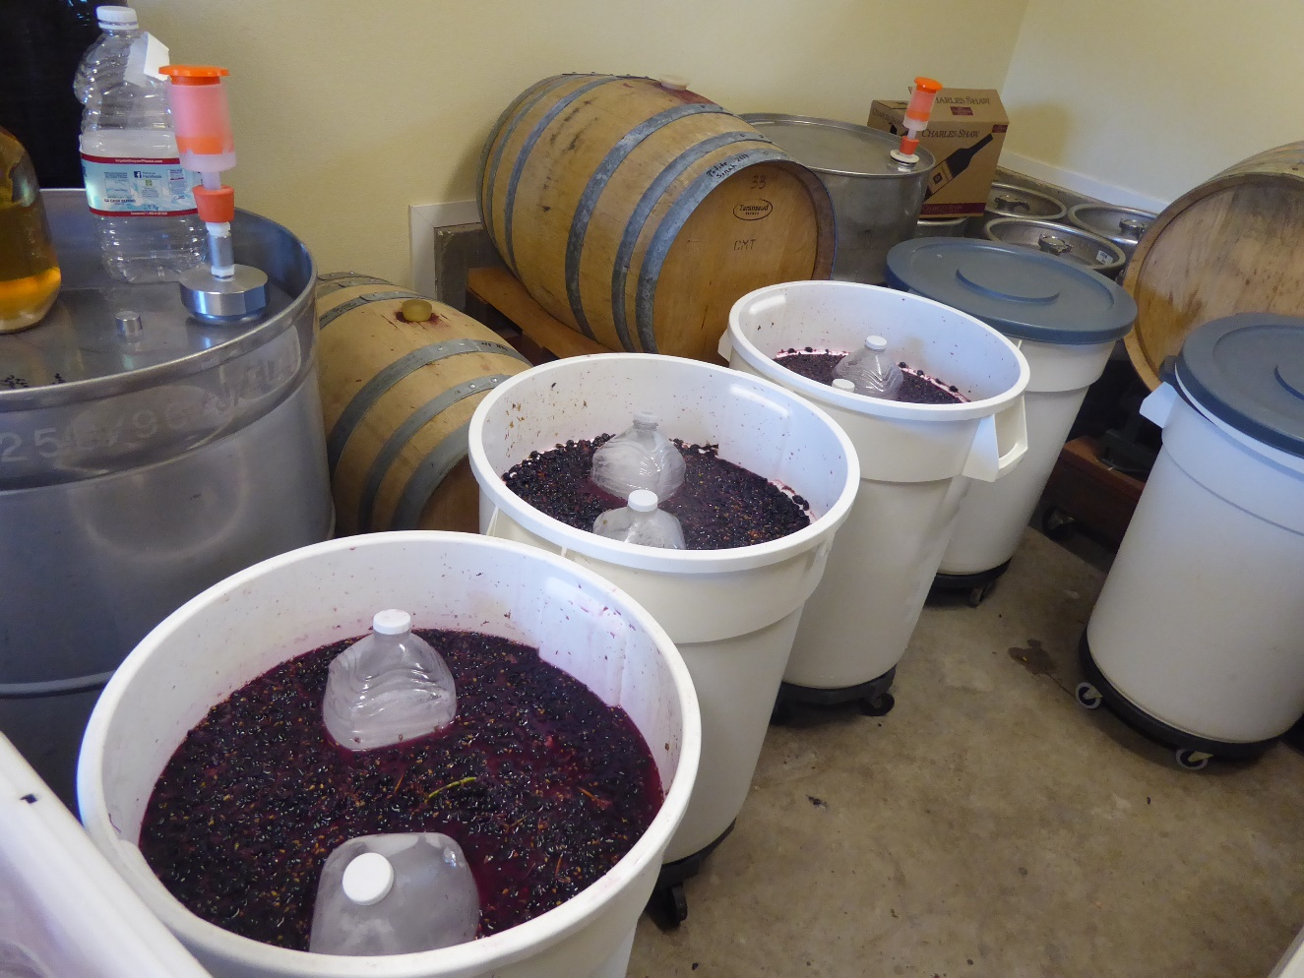
Cold-soak (skin contact) or maceration:
‘water extraction’
Pro: increased extraction of aromatics, varietal character, color, and skin tannins
Con: exposure to spoilage organisms if not cold enough, or spontaneous fermentation
time: 2 to 5 days
SO₂ is essential
keep cold <50ºF
best for Pinot, Grenache, Zin
blanket with inert gas (dry-ice)
Fill level

Slide 37
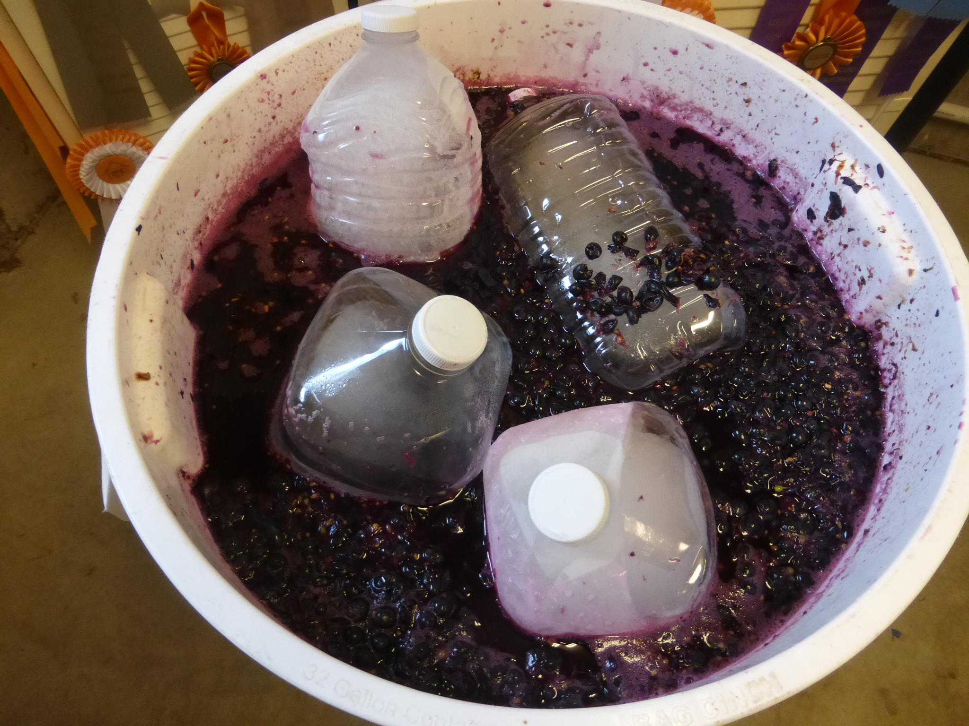

Slide 38
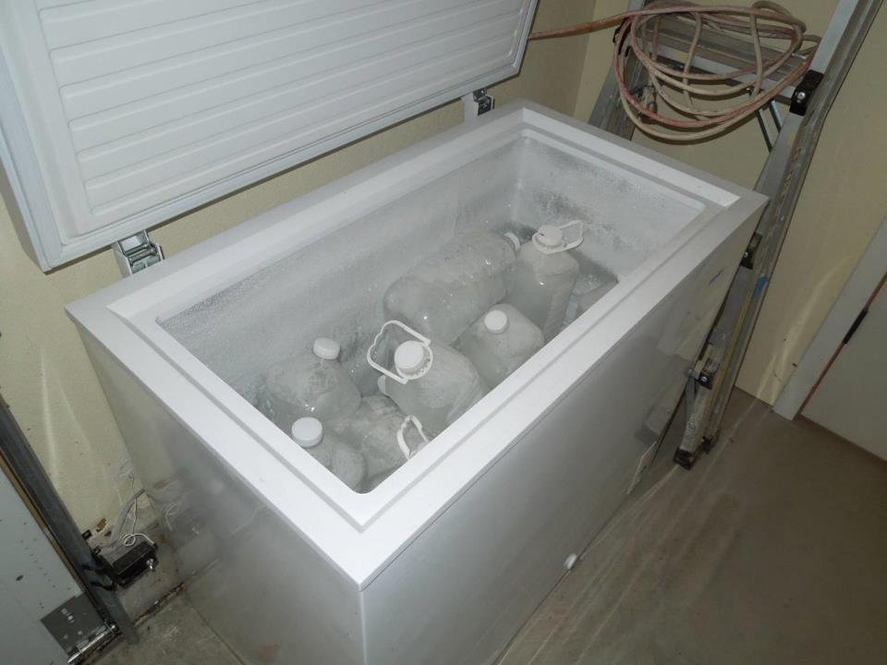
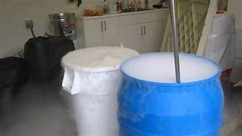

Slide 39
Benefits of cold soak?
jury is still out …
more skin time for color extraction and aroma pre-cursors before alcohol (a powerful solvent) is produced
cooler fermentations
“frontloading” as one winemaker put it, allowed her to use a soft touch during fermentation and post-fermentation
fewer punch downs
fewer rackings
Pinot and Zin seem to respond

Slide 40
Enzymes:
used after Sulfiting, during cold-soaking, or start of fermentation
increases maceration: the extraction of pigments, and tannins
stabilizes color
examples: Scott’s Color Pro, Enartis, Zym Color-Plus
masks herbaceous/vegetal notes
more body and improves mouthfeel
increases yield
allow 6 to 8 hours to work, before adding tannins

Slide 41
Fermentation tannins: Ft Rouge Soft, Enartis Tan Rouge
act sacrificially to preserve natural skin tannins
used after sulfiting, during cold-soaking, or start of fermentation
increase maceration: extraction of pigments and tannins, aromas, and intensify and stabilize color
improve aromas by masking green/herbaceous notes, and adds roundness
are powerful antioxidants
increase yield, breaks down pectins
a stylistic tool

Slide 42
Testing: getting a representative juice sample:
provides critical information: °Brix, pH, TA, and Nutrient availability (YAN)
allows you to make adjustment and manage fermentations better
sampling-error is a big problem
collect from a pooled source, 24 to 48 hrs. after crushing
home pH meters ‒ a major source of error – calibrate, get pH buffered standards

Slide 43
Adjusting acidity: TA (titratable acidity) and pH:
Lab analysis: (juice-panel): pH, TA, °B, YAN
TA: amount of acid, tartness – affects taste, balance
typical range is ~ 5 to 10g/L
ideal range or 6 to 7 g/L
pH: a measure of acidity–conc. of H⁺ ions
typical range: 3.2 to 3.8
Ideally: 3.3 to 3.5
prioritize adjusting pH, TA will take care of itself in time
adding Tartaric acid: pH↓ and TA↑
adding Potassium Bicarbonate: removes Tartaric acid – pH↑ and TA↓
need a good pH meter, and scale

Slide 44
PH is freaking important, why is that?
affects color, taste, stability (determines ppm of free-SO₂ needed to prevent oxidation and microbial spoilage)
important concept: the lower the pH, the higher the acidity, the lower the acidity, the higher the pH
the pH of wine grapes often > 3.5
adjust pH to ≤3.5 before fermentation
Tartaric acid lowers pH, drives TA up
lowering TA 1g/L can raise pH up to 0.2 units, so go slow
calibrate meter first

Slide 45
Adjusting sugar >25°Brix – ‘Watering-back’
dilute must to lower potential alcohol
use bottled water
addition based on expected yield: 10 gal. must yields between 6 to 7 gallons of juice. 1000 lbs of fruit yields 60 to 70 gal
On average, 60 to 70 percent of the must is juice, depending on grape size.
Rule of thumb: to lower the B° 1 unit, add 150 mL of water for each gal. of juice in the must (2.37 gal for a 59 gal barrel)
typically you need to add acid to compensate

Slide 46
Fermentation: conventional or walk on the wild side ?
many cultured yeast strains: convenient, expedient, reliable, and predictable…
select for: affinity, alcohol tolerance, nutrient-demand, speed, temperature range, H₂S production, O₂-needs, sensory impact (aromas, flavors and mouth-feel)
prudent to use a yeast with low to moderate nutrient-demand
or, allow the natural wines on the grapes to have a go at it
indigenous yeast: slow to buildup, so start the buildup early
and no SO2 or a low dose prior to fermentation

Slide 47
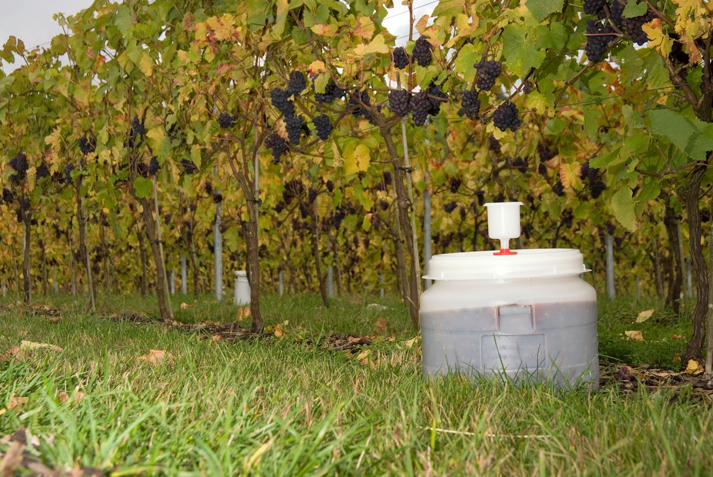
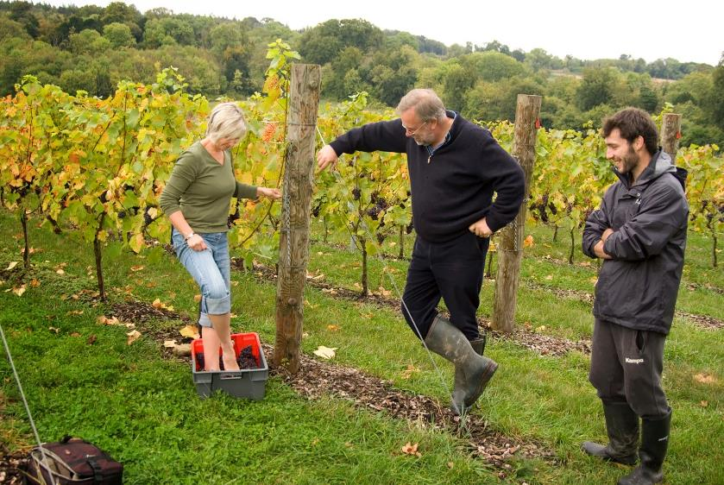
Pied de cuve

Slide 48
Fermentation – some tips
select yeast carefully: a major source of problems
use enough yeast to dominate spoilage bacteria and indigenous yeast
rehydrate yeast
allow cold must to warm: 55 to 60°F
yeast quickly become active in warm must – shorter ferments
acid adjustments, when appropriate, produce better outcomes
yeast buildup and viability, dependent on nutrient availability
fermentation speed increases with temp along with nutrient-demand
don’t exceed yeast’s temperature range
maintain skin-contact
aerate fermenting must, O2 deficiency can limit proliferation or lead to H2S
monitor for sluggishness from about 8 °Brix to completion
take action if °Brix remain unchanged for more than 24 hours

Slide 49
Help the yeast do their work – feed them!
nutrient deficiencies common
how would you know? Have a sample tested for YAN (just do it!) <130 mg/L is deficient
when YAN is low to moderate, fermentations likely to falter
implication: H₂S, sluggish or stuck fermentations ☹
avoiding problems: add right amount at the right time:
critical stages: inoculation, ⅓ and ½ sugar-depletion
many nutrient options, most are blends of amino acids and other critical nutrients, some are combined with DAP (1/3 sugar depletion)
don’t rely on DAP

Slide 50
Yeast depend on nutrient availability in the grapes
nutrient availability (YAN) determines yeast replication, fermentation rate, and outcome ‒ good or bad!
the higher the °B, the lower the YAN
yeast strains have varying needs
nutrient demand increases with fermentation temperature
bacteria can consume significant N during cold-soaking (not cold enough and/or SO2 is too low
use balanced nutrients: amino acids, survival factors, vitamins, and minerals
amino acids ‒ critical precursors for varietal aromas/flavors
excess DAP stimulates growth and nutrient-demand
No DAP first 12 hours after inoculation
DAP is best used to bring YAN to a minimum level

Slide 51
Factors affecting fermentation & outcome:
use of Sulfites–an antimicrobial
yeast strain: suitability, attributes, tolerances
yeast viability: old
inoculum levels, rehydration, temp
°Brix (potential alcohol)
nutrient deficiency
temperature management: too cold, too hot, or just right, and duration
Oxygen availability
acidity: pH , ≥3.8 will allow Lactobacillus, Pediococcus
cap management
skin-time (short vs. long)

Slide 52
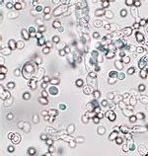
Conventional fermentations:
rehydrate -- warm water (~100°F) before adding yeast
use a rehydrating nutrient (greater survival and faster buildup)
acclimate yeast before inoculation
after 15 to 20 min., gradually begin adding juice to cool the mixture at 20 minute intervals
cool to within 10°F of must temp
something new!! GoFerm Sterol Flash

Slide 53
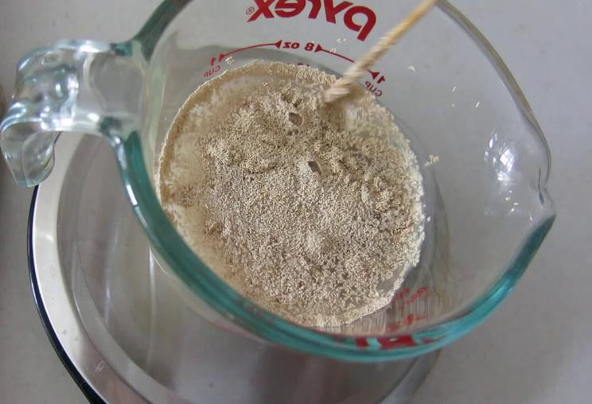

Slide 54
Fermentation after inoculation:
nutrients needed shortly after yeast inoculation, unless YAN is sufficiently high
allow fermentation to ramp up gradually unless …
bubbling and ‘cap’ formation within 24 to 48 hours
long, slow fermentations produce better wines
monitor temperature: don’t exceed yeast’s upper limit
monitor change in °Brix daily, plot the progress
shoot for 12 to 14-day fermentations 77-83°F (upper limit 86°F)
Exponential growth vs. stationary phase where the yeast are responding to growth-inhibiting effect of increasing alcohol.

Slide 55
Scott Labs (Lallemand) nutritional program:
Need to know °Brix and YAN
Select yeast best suited to these factors
Determine yeast’s relative nutrient needs (low, medium, or high)
Notice the rate goes up with °B and ‘required YAN’
Determine how much extra N to add: 0-50, 51-100, or 101-150 ppm
Start by rehydrating yeast with a nutrient (Go-FERM Sterol Flash)
Ex. grapes: °26 Brix, YAN 97 ppm, the yeast’s nutrient demand is low. You need 195, but have only 97, so add 98 more ppm of YAN.
How much, when? follow Scott’s Nutritional Plan
LOW Nitrogen-demand: 7.5 ppm per 1 °Brix
MEDIUM Nitrogen-demand: 9 ppm per 1 °Brix
HIGH Nitrogen-demand: 12.5 ppm per 1 °Brix

Slide 56
You have 97 ppm of YAN, but need 195, so you are short to the tune of 98
When: at rehydration, at a 2 to 3°B drop, add 30g h/L Fermaid 0, and at 1/3 sugar-depletion add 40 g
If you have problem around 8 °Brix add RESKUE

Slide 60
Fermentation temperature influences fruit flavors, color, and body:
fermentation produces heat: aids in tannin extraction
cooler temperatures (77–83°F) produce fruitier more palatable reds, easy drinking…
hot ferments tend to extract harsher, more astringent tannins, (puckery, mouth-drying, or bitter sensation)
Higher, but moderate temperatures (≤ 86°F) produce longer-lived, more tannic wines
Tannins and alcohol contribute to body, and can add a silky, round, slightly sweet finish, if you know how to manage them
in general, you’re on thin ice above 86°F for most yeasts

Slide 61
Punching-down: what’s the point?
break up and resubmerge cap
suspend lees and yeast
allow odors to dissipate
facilitate extraction of color, aroma, and skin tannins
incorporate a little air initially
dissipate heat: cap acts as an insulator
kill air-borne bacteria that settle on cap
frequency influences amount of tannins and style
what’s reasonable? 1 to 3 times/day
frequent and energetic punch downs, use of enzymes, and warm ferments (>80°F), all serve to increase extraction
how you manage tannins makes all the difference:

Slide 63
Aerating the must:
Yes, aeration is the enemy of wine, but not fermenting wine
significant benefits during fermentation
yeast are aerobic, but fermentations are largely anaerobic
providing air to support yeast growth (build up), and maintain viability
improves fermentation efficiency, and makes wine more palatable: fruitier, softer, rounder and less astringent. Bingo!
minimizes of H2S production, while allowing them to dissipate
fermentations less likely to falter

Slide 64
Wineries do ‘pump- overs’, ‘délestage’

Slide 67
Once the cap settles, you’re done … unless the wine is stuck…. Noooo!

Slide 69
Hydrometer: measures relative specific gravity or Brix/Balling Temp °F spec. grav. correction 50 - 0.5 60 + 0 70 + 1 77 + 2 84 + 3 Ex. If SP is 1.100 and the temp is 84F the correction is .003, so the corrected SG is 1.103 www.winebusiness.com/calculator/winemaking/calc/67/ A specific gravity of 0.990 to 0.996 is considered dry

Slide 70
Pressing:

Slide 72
Seed removal before pressing

Slide 73
Collecting the free-run and press-run

Slide 75
Settling: grape solids and yeast

Slide 76
‘Cake’

Slide 78
Racking:

Slide 80
Malolactic conversion:
natural process involving bacteria
bacteria found on grape skins
may occur spontaneously, best to inoculate
Malic acid converted to Lactic acid. CO2 ↑
Malic acid is tart, Lactic acid is not!
smoother, rounder, fruitier, and more complex)
When? after fermentation, pressing, settling, and racking
to get rid of gross lees
wine is often racked when ML done

Slide 82
Malolactic conversion:
what to look for: potential alcohol, free- and total-SO2
some ML cultures must be rehydrated, others added directly
use a hydrating nutrient (ActiML, Osmobacti)
an ML nutrient is also recommended (Nutriferm ML, and Scott has ML Red Boost, and OptiMalo-Plus
temperature: ideally 72 °F, 76°F max
keep barrels topped, and use inert gas
when activity ceases, test remaining Malic

Slide 83
Post-MLC:
time to add 60 ppm SO₂
you need more than you think
you have virtually no remaining free-SO2 and,
roughly half will bind within a few days
dissolved O2 increases during racking (10 to 15 ppm)
wine in barrels lose about 5 ppm/month
every time you pull the bung to smell, taste, or add something you lose SO2
allowing free-SO2 to drop below the targeted value between testing and additions is inviting trouble

Slide 84
Final acid adjustment:
Favorable acidity: pH 3.5 to 3.75, TA 6 to 7 g/L
To raise acidity: 3.8 g/gal (Tartaric acid): TA↑1g/L pH ↓ 0.1 -0.2 pH units
To lower acidity: 3.4 g/gal (Potassium Bicarbonate): TA ↓ 1g/L , pH↑
Make additions gradually and check pH after each addition.

Slide 85
Current minimum free-SO2 Source: The Australian Wine Research Institute, in their publication Revisiting Sulfur Dioxide Use, based on research by Rankine, 1989. www.winebusiness.com/calculator/winemaking/calc/21/
pH 3.40 to 3.60 | 10 to 20 mg/L ‘apparent^{1′} free SO₂ or 50 to 150 mg/L total SO₂
pH > 3.60 | > 20 mg/L ‘apparent’ free SO₂ or > 150 mg/L total SO₂
pH | 0.8 ppm | 0.5 ppm
 | White Wine | Red Wine
2.9 | 11 ppm | 7 ppm
3.0 | 13 | 8
3.1 | 16 | 10
3.2 | 21 | 13
3.3 | 26 | 16
3.4 | 32 | 20
3.5 | 40 | 25
3.6 | 50 | 31*
3.7 | 63 | 39*
3.8 | 79 | 49*
Some assumptions: the wine is sound, the barrel is clean, you stay on top of sulfiting, you adjust high pH wines to 3.7 or less.
It’s prudent for home winemakers to increase minimum F-SO₂ to 30 ppm at 3.6 to 3.8

Slide 86
Maturation: time to resolve issues:
Clarification: remove suspended solids, tartrates, insoluble pigments, tannins, etc.
Stabilization: minor acid adjustment, maintain targeted molecular SO2, and eliminate bacteria as needed
Fining: moderate astringency, bitterness Sensory improvements: treat off aromas, ‘finishing’ tannins to improve body, and reduce astringency, add oak
Mouth-feel: polysaccharides, mannoproteins, gum Arabic
Filtration: stability and appearance
Duration: reds 14 to 24 months in oak, in stainless 8 to 12 months
Tips: fill containers! Top barrels frequently, test SO2
Cold stabilization

Slide 87
Oak barrel alternatives or neutral barrels:

Slide 88
Topping up and inert gas:

Slide 89
Racking: clarification and limited O2 exposure:
Racking: transfer of clear wine off sediment (siphoning, pumping, or gas-transfer)
Most home winemakers rack 3 or more times:
First: post-fermentation after pressing and settling of gross lees.
Second: just after MLC (following sulfite addition)
Third (or more): after fining and/or just before bottling to remove additional sediment

Slide 92
SO₂ at bottling:
To account for depletion of SO₂ due to air exposure, add 10 to 15 ppm for a standard 3 to 5-spigot bottlers, or 5ppm for an Enolmatic filler.
You must also account for the immediate binding of the SO₂ after it is added to the wine. Only part of it will remain free–about 70 to 75% when added to a clean, dry red.
Let’s say you plan to add 18 ppm to achieve the targeted free-SO₂ level. Some of it will bind up, so, you need to add ~26 ppm to ensure that your wine is protected. (18 ÷ 0.7 = ~26ppm)

Slide 93
Enolmatic
Buon Vino Super Auto
Standard bottlers

Slide 95
The character of finished wine is determined by everything that is done or not done along the way…..

Slide 96
Some parting thoughts:
Try to find the right balance between controlling every stage of winemaking and allowing nature to have a hand in it …
Strive to make distinct wines, that are balanced with varietal character, and with a sense of place …

